Slide 1
A Statistical Approach for Outlier Detection with KMeans
Shubham Shah , Yash Amin
Guide : DR. Anjali Jivani, dr. hetal bhavsar

Slide 2
Approach for Outlier Detection Revisited…
Algorithm Flowchart :
Check Data Dimension
Single Dimension
Yes
No
Distribution
Distribution
Normal
Non Normal
Normal
Non Normal
Z score
IQR
MCD
Isolation Forest

Slide 3
Selection of Statistical Test for Univariate Normality
Statistical Tests to be considered :
Anderson Darling Test
Kolmogorov Smirnov Test
Shapiro Wilk Test
Jarque Bera Test
Lilliefors Test
D’Agostino’s K^2 Test

Slide 4
Time Complexity Analysis for Univariate Normality Test
Time taken by statistical test along with its outcome is measured for synthetic dataset having very large size ( 5 x 10^7 – 10 x 10^7)
Observation :
Jarque Bera test is taking least time among all the tests
Shapiro Wilk test failed ( giving incorrect outcome ) for large size datasets
Outcome : Shapiro Wilk test should not used for normality Analysis
Question : Whether Jarque Bera test should be considered or not ?
Report Link : ..\Reports\Time Complexity Analysis of Normality Test.docx

Slide 5
Selection of Statistical Test for Multivariate Normality
Total Available Statistical Tests : 8
Statistical Tests to be considered :
Shapiro Wilk Test
Jarque Bera Test
Doornik Hansen Test
Lilliefors Test

Slide 6
Time Complexity Analysis of Multivariate Normality Tests
Time taken by statistical test along with its outcome is measured for synthetic dataset having very large size ( (2.5 x 10^5,5) – (5 x 10^6,25))
Observation :
Jarque Bera test is taking least time among all the tests
Shapiro Wilk test failed ( giving incorrect outcome ) for large size datasets
Outcome : Shapiro Wilk test should not used for normality Analysis
Question : Whether Jarque Bera test should be considered or not
Report Link : ..\Reports\Time Complexity Analysis of Normality Test.docx

Slide 7
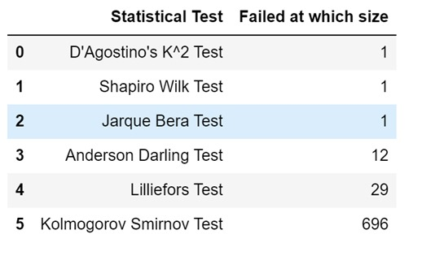
Effect of Skewness and Kurtosis on Univariate Test
Experiment : Imputing data points in normally distributed data ( size : 50000 ) which increases the tailedness of data distribution
Observation on High Tailedness : ( Data points imputed between -10 to 10)
Table 1 : Analysis of Statistical Tests on Outliers

Slide 8
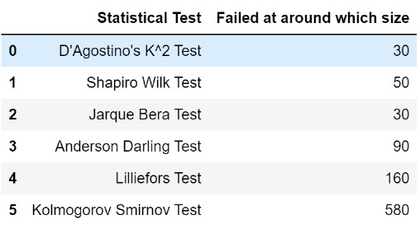
Observation on Low Tailedness : ( Data points imputed between -4 to 4 )
Table 2 : Analysis of Statistical Tests on Outliers
Analysis of Statistical Tests for Normality : ..\Reports\Analysis of Statistical Tests for Normality.docx
Conclusion : Consider Anderson Darling test for Univariate Normality Analysis

Slide 9
Effect of Dispersion of data on Statistical Tests
Experiment : Generated Normally distributed data having high value of standard deviation i.e. > 1 and then check statistical tests are giving correct outcomes or not
Observation : All the statistical tests passed i.e. Correct outcome regarding normality of data
Reason : As the value of std increases not only mean ( x bar) is affected but observations (xi) is also affected so ultimately it won’t cause in effect in skewness and kurtosis
Conclusion : Statistical tests are not affected by dispersion of data ( Standard Deviation)

Slide 10
Selection of Outlier Detection Algorithm for Multidimensional Data following Normal Distribution
Existing Algorithms :
Mahalanobis Distance with Outlier Detection
Elliptic Envelope
Minimum Covariance Determinant
Experiment Performed : 2D normally distributed data is generated and outliers are observed for different value of contamination
Observation : Same outliers are given by all the methods for specific value of contamination
Report : ..\Reports\Outlier Analysis for Normal Data using Scatter Plot.docx
Question : Which method should be selected among these ?

Slide 11
Further study on Outlier Detection Techniques for Normally distributed data
Mahalanobis distance for outlier detection and Elliptic Envelope both techniques are affected by outliers . Why ?
Minimum Covariance Determinant is robust to outliers in data . Why ?
Conclusion : Consider MCD algorithm for outlier detection when the data is following Multivariate Normal distribution

Slide 12
Selection of Outlier Detection algorithm for Multi Dimensional Data not following Normal Distribution
Existing Algorithms :
IQR ( Only 1D)
Isolation Forest
Local Outlier Factor
One Class SVM
Experiment Performed : Datasets having labeled outlier have obtained and these algorithms are evaluated based on % of outliers detected, Precision and Recall
Dataset Resource : ODDS Datasets

Slide 13
Observation on algorithms detecting outliers in Non Normal data
Isolation Forest
works well among all the algorithms for detecting global outliers from data
Problem : False Positives when Contamination is ‘auto’
Local Outlier Factor
Works well for identifying local outliers of respective clusters
Problem : Parameter n_neighbors is required to be tuned otherwise it may not work well
One Class SVM
Unable to properly identify outliers from data
Reason : Tries to create hyperplane which separates regular data points and outliers
Report : ..\Reports\Outlier Analysis on Labeled Outlier Data.docx

Slide 14
Effect of Density of Clusters on Isolation Forest
Case : Data is clustered in such a way that their exist dense and sparse cluster together i.e. Some clusters are dense and some are sparse
Question : Which data points will considered as global outliers ?
Problem : It may be possible that outlier detection algorithm applied on this data may return those data points as outliers which are part of sparse cluster rather than the actual global outliers of data
Experiment Performed : Data generated having Dense cluster and Sparse cluster and outliers given by specific value of contamination is observed
Outcome : Isolation Forest is robust to cluster density

Slide 15
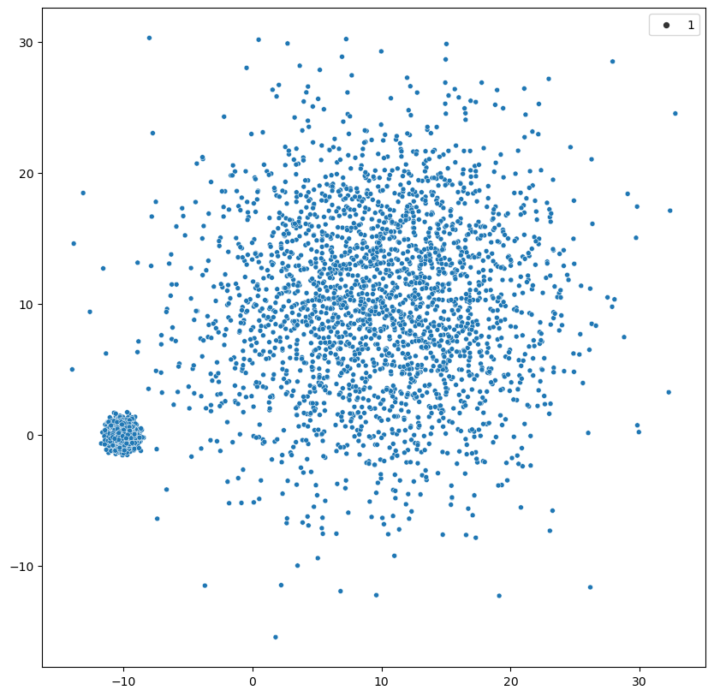
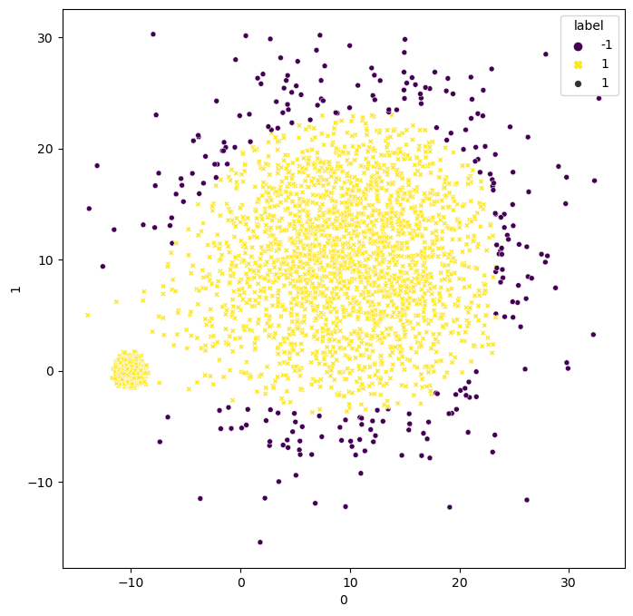
Observation on varying Cluster Density
Fig.1 : Scatter Plot of Data
Fig.2 : Outliers given by Isolation Forest

Slide 16
Functionalities of Modified Algorithm
Automatic selection of K value using Silhouette Score
Only Outlier Detection without Clustering
Implemented Hopkins Statistics to check whether the data can be clustered or not after removing outliers from data

Slide 17
Revised Statistical Approach
Before KMeans Clustering everything remains same
Apply Hopkins Statistics on filtered data having no Contamination
If value of Hopkins Statistics < 0.5 :
Data Can not be Clustered
Else :
After removing outliers from data find the silhouette score for different values of K and K value having highest silhouette score will be optimal K and KMeans algorithm will be applied to data with that optimal K value

Slide 18
Comparison between Suggested Approach and Existing Approach
Existing Approach : Use DBSCAN algorithm to identify outliers and after perform clustering
Problem with DBSCAN : 2 hyperparameters required to be tuned i.e. MinPts and Epsilon
Advantage with suggested approach : Automatic Selection of K value , Only contamination value is needed ( If known )
DBSCAN is density based approach i.e. Existence of varying density cluster may result in False Outliers but this is not the case with Isolation Forest

